Slide 1
T-SQL Best Practices & Tuning
For the BI/DWH Developer (and the data engineer)

Slide 2






contact
Koen Verbeeck
@Ko_Ver
SQLkover.com

Slide 3
a quick word about best practices

Slide 4


Slide 5
IT DEPENDS

Slide 6
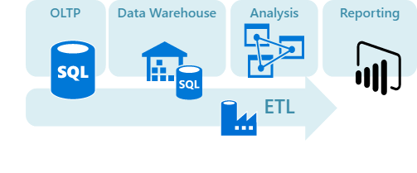
typical data warehousing scenario
2
SQL in SSAS
4
SQL in the DWH
SQL in SSRS/Power BI
SQL in SSIS/ADF
3
1
Source: Azure Data Architecture Guide - https://docs.microsoft.com/en-us/azure/architecture/data-guide/
Notes:
the goal of this session: sort of a braindump of all my tuning knowledge amassed over the years. Like mentoring a junior on their first weeks and mentioning “this is some stuff you need to take into account…”

Slide 7
what we’re not going to talk about…
Synapse Analytics
SQL Pools - T-SQL is mainly the same, but distribution is a different beast
Serverless - not actually T-SQL https://www.youtube.com/c/DataToboggan/videos
Databricks - Spark SQL ain’t T-SQL
Streaming
Definitely not about U-SQL…

Slide 8
SSIS

Slide 9
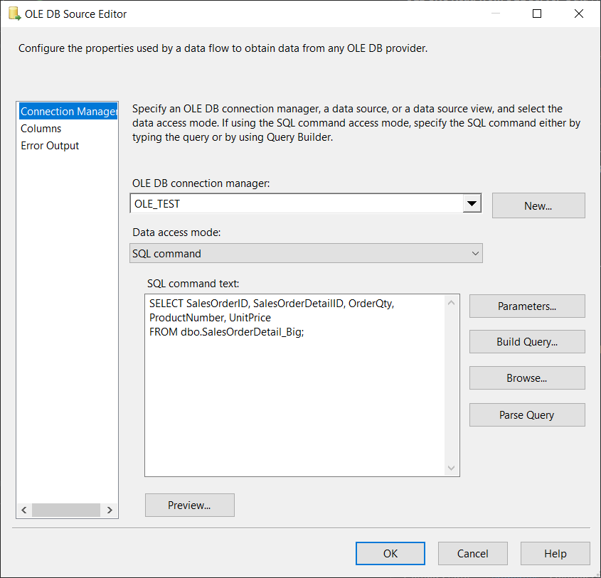
read from database
always write a SQL statement
DO NOT USE THE DROPDOWN
do as much calculations in the query as possible
make columns as narrow as possible
ALWAYS
ALWAYS

Slide 10
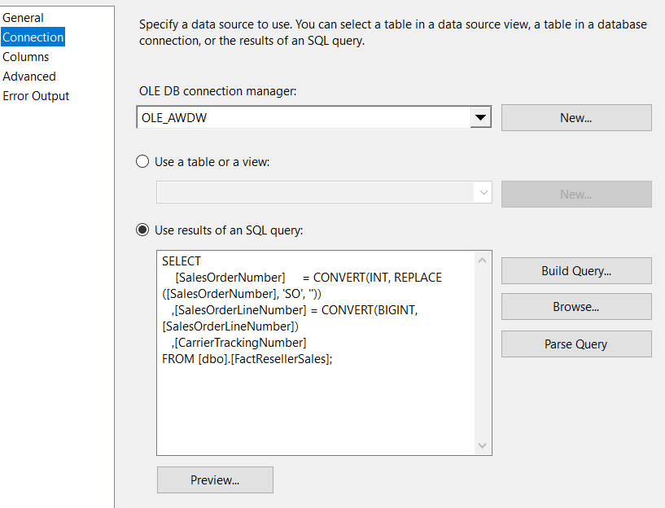
lookup
ALWAYS

Slide 11
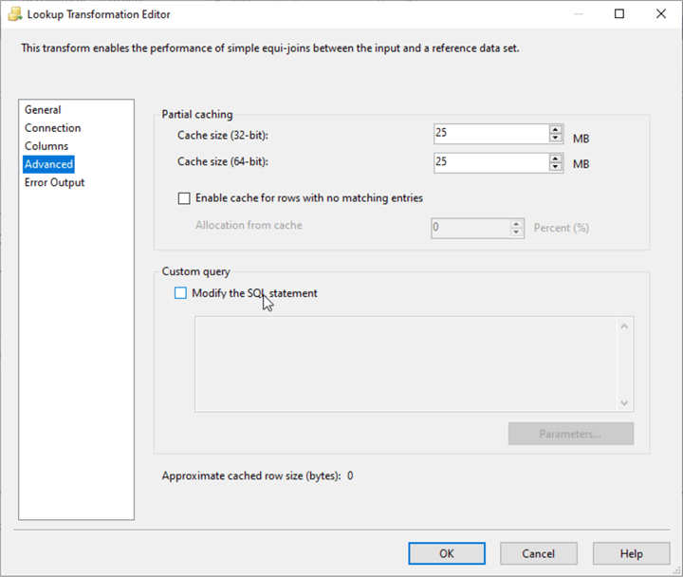

lookup
don’t try to be smart and use custom query and partial caching to implement range lookups
Notes:
dump the data in a staging table and write some SQL dammit

Slide 12
OLE DB Command
DO NOT USE IT

Slide 13
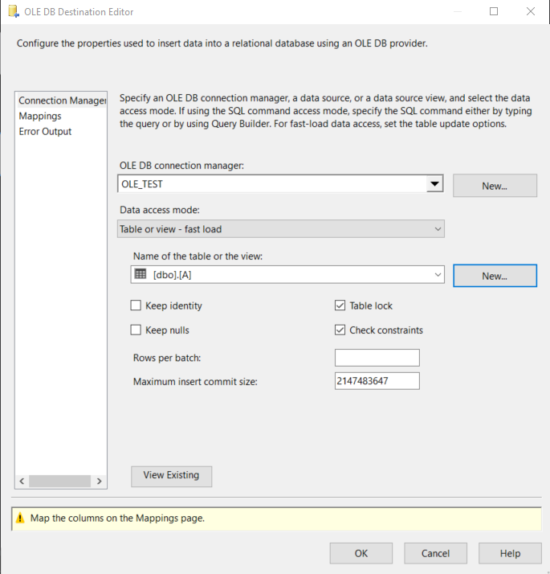
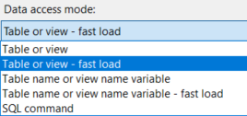
write to database

Slide 14
ADF

Slide 15
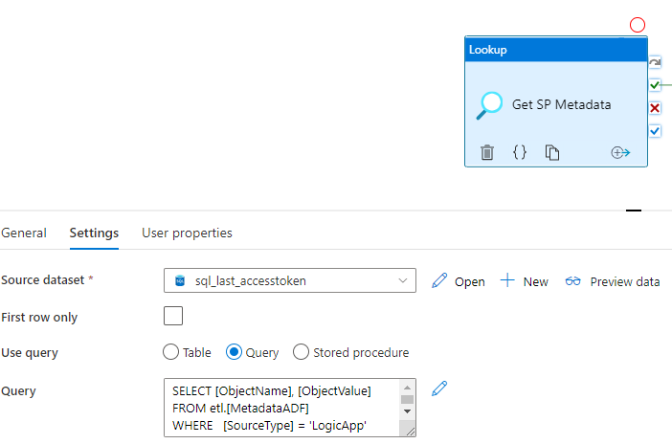
Lookup/Copy/Script Activity
Notes:
very similar to SSIS. Do as much in the query as possible. Only take columns you need.

Slide 16
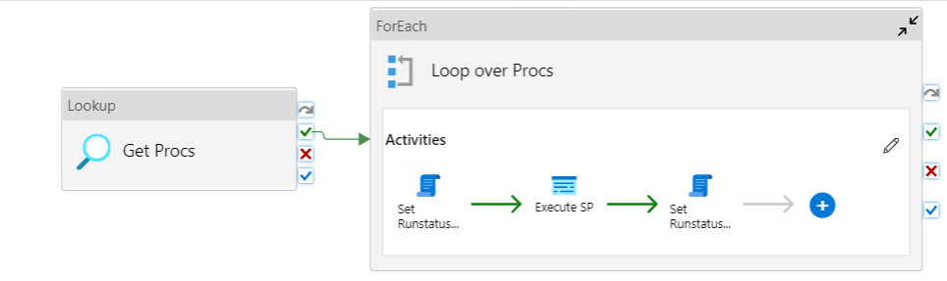
Parallelism FTW
Notes:
Use an orchestrator

Slide 17
SSAS / Power BI

Slide 18
T-SQL is only used to pull data in
be careful of performance if you do lots of complex logic
persist if needed through clustered view or reporting table
only get the columns you need
reduce cardinality
maybe use the money data type?
write some decent SQL, obviously

Slide 19
SSRS

Slide 20

use the Query Luke
SSRS
SQL

Slide 21
use the Query Luke
grouping, sorting, filtering → SQL
watch out for parameter sniffing https://www.brentozar.com/sql/parameter-sniffing/ Free webcast on October 20th
don’t overly rely on .NET
you can calculate running totals using window functions for example
if logic is too complex, persist the result set
the more you do in SQL, the better

Slide 22
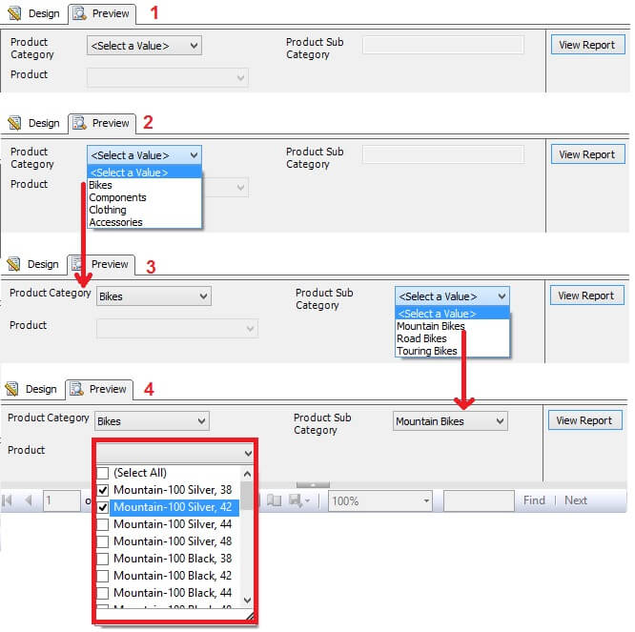
limit parameter values
implement cascading filters
users will love you since they don’t have to scroll through 1000+ parameter values
you only send queries to the database with small result sets

Slide 23
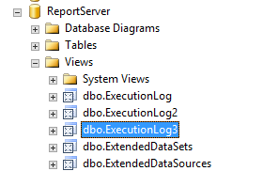
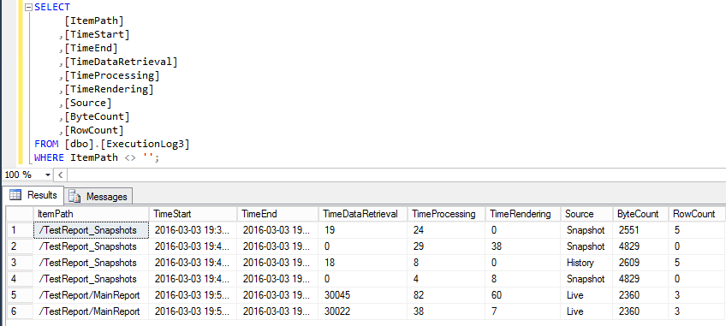
use the logs to find bottleneck

Slide 24
the data warehouse

Slide 25
a little DBA knowledge…

Slide 26
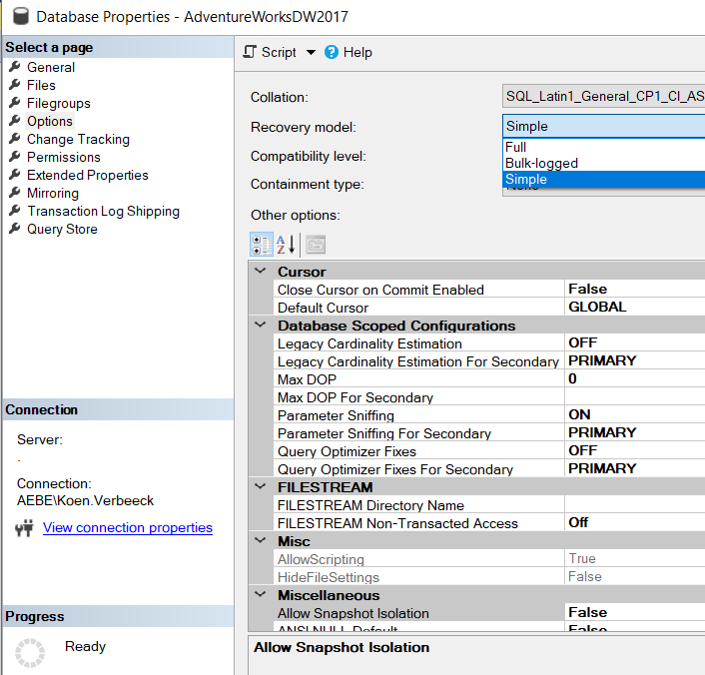
recovery models
do you really need point-in-time recovery?

Slide 27

database files
check the auto growth settings
pre-allocate size
multiple files & filegroups
please don’t use the C:\ drive

Slide 28

tempdb
you only have one
don’t turn it into a bottleneck

Slide 29

Notes:
make sure you have a decent server, one that is faster than my laptop

Slide 30
and what about Azure SQL DB?
none of the previous matters, Microsoft does it for you
it’s all full recovery model
make sure you know which tier you’re on

Slide 31
data warehouse design

Slide 32
STAR SCHEMA ALL THE THINGS

Slide 33
dimensions
wide tables, many columns
not that many rows
only use columns you actually going to need
use NVARCHAR only when necessary, e.g. names, addresses
avoid BLOB columns

Slide 34
facts
long, small tables
many, many rows
again, use only columns you need
take the smallest data type possible
avoid BLOB and NVARCHAR as well

Slide 35

facts
good candidates for row/page compression
reduce size to 40% or more
less IO
available in Standard Edition since SQL Server 2016 SP1

Slide 36
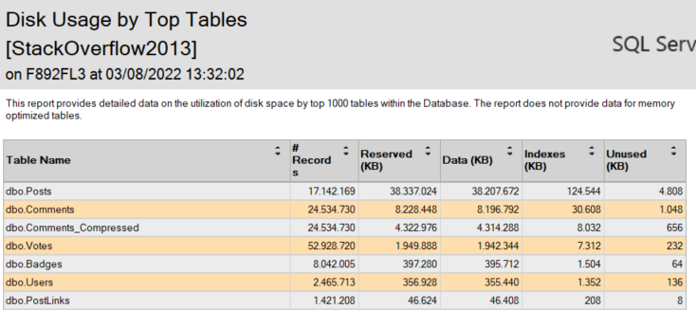

Slide 37
staging tables
preferably a heap
truncate & load
indexes only to improve SELECT queries
disable before load and rebuild after load
try incremental load for bigger tables

Slide 38
let’s talk about SQL
Notes:
focus is on SELECT

Slide 39
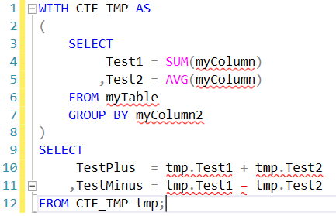
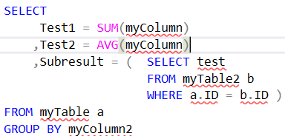
tips & tricks for the SELECT statement
filter as early as possible
use CTEs for readability
break-up with temp tables if performance is not OK
avoid correlated subqueries
watch out for parameter sniffing (again)

Slide 40
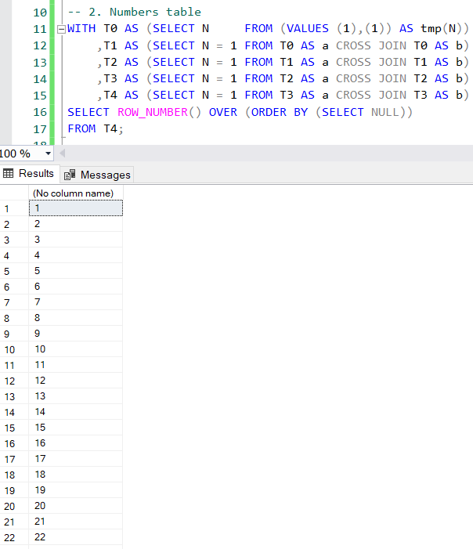
this is not Oracle
don’t use CURSOR
or WHILE loops
unless for management activities
avoid row-by-row operations
rather use tally table (numbers table) or window functions
set-based thinking FTW

Slide 41
avoid user-defined functions
if you need to use scalar functions
make sure they’re inline
set NULL ON NULL INPUT if applicable
minimize the data set over which they are calculated
use inline table-valued functions
multi-statement table-valued functions?
https://sqlserverfast.com/blog/hugo/2012/05/t-sql-user-defined-functions-the-good-the-bad-and-the-ugly-part-1/
NEVER

Slide 42
DEMO
Notes:
Cursor vs window function
UDF

Slide 43
what if your SQL is slow?
Notes:
focus is on SELECT

Slide 44


Slide 45

clustered index
every table wants one
can be an identity column
can be a date or other partitioning column
column order matters

Slide 46
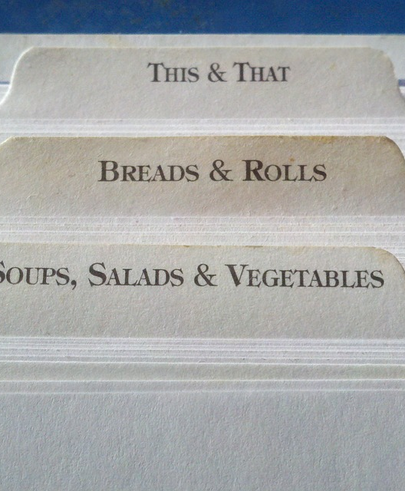
non-clustered index
speed up SELECT queries
impacts other queries, especially DML
extra copy of the data
keep an eye out for unused indexes

Slide 47

columnstore index
especially useful for data warehouses
typically the entire table
can be used with in-memory OLTP
prerequisite for batch mode (< SQL Server 2019)

Slide 48
columnstore
SELECT A FROM myTable;
A
A
A
A
A
A
A
A
A
A
B
C
D
A
B
C
D
A
B
C
D
A
B
C
D
A
B
C
D
A
B
C
D
A
B
C
D
A
B
C
D
A
B
C
D
page
page
page
disk

Slide 49
columnstore
SELECT A FROM myTable;
A
B
C
D
A
B
C
D
A
B
C
D
A
B
C
D
A
B
C
D
A
B
C
D
A
B
C
D
A
B
C
D
A
B
C
D
disk

Slide 50
rowgroups & column segments
group of rows compressed at the same time
max 1,048,576 rows
column of data within rowgroup
min/max values are kept
A
B
C
D
A
B
C
D
A
B
C
D
rowgroup
A
B
D
A
D
D
C
B
C
A
B
C
A
B
C
D
column segment
A
B
C
D
A
B
C
D
https://www.nikoport.com/columnstore/

Slide 51
index recommendations - dim
primary key (= clustered index) on the surrogate key
helps with joins from fact table to dimension
allows for quick lookups / updates
unique non-clustered on business key
helps with lookup on BK when trying to match incoming records
in case of SCD Type 2, add ValidFrom column + maybe column to indicate last record
+ any non-clustered index needed for performance

Slide 52
index recommendations - fact
primary key (= clustered index) on the (sub) set of surrogate keys that make a fact row unique
not always possible, sometimes you need an identifier such as invoice ID (degenerate dimension)
or non-unique clustered index on certain surrogate keys
with potentially unique non-clustered index

Slide 53
index recommendations - fact
almost always SK to date dim is the first column of the index
for large facts: columnstore indexes if DWH is directly queried
+ additional non-clustered indexes for performance

Slide 54
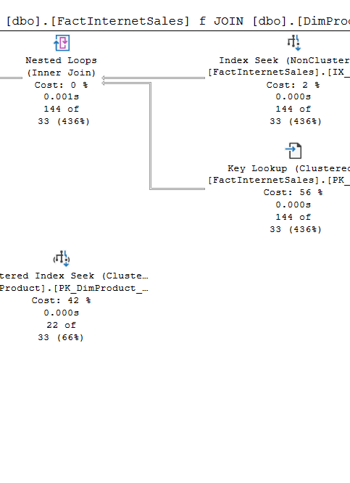
index tips
check out missing indexes in query plan
don’t blindly follow it though (and don’t forget to rename)
sp_blitzindex
avoid overlapping/redundant indexes
SARGable queries are preferred
beware of implicit conversions
make an index covering
avoid bookmark/key lookups
use INCLUDE columns

Slide 55
DEMO
Notes:
SARGable query
Covering index

Slide 56
conclusion

Slide 57
conclusion
There are a few “rules” you can follow
Indexes are magic
Performance tuning can be a dark art
The more practice, the better

Slide 58
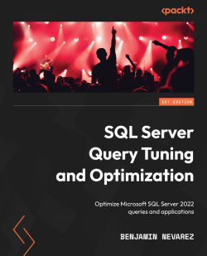
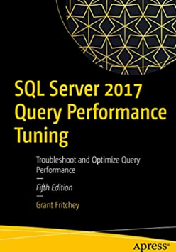

resources
Performance Tuning Tutorial
First Responder Kit by Brent Ozar
How to Think Like the SQL Server Engine
Columnstore Index webinar
The SQL Server Numbers Table, Explained
How to Expand a Range of Dates into Rows using a SQL Server Numbers Table

Slide 59

Feedback?

